Slide 1
Fermilab Batavia, Il
Particle acceleration and detection
Richard Lasky – Summer 2010

Slide 2
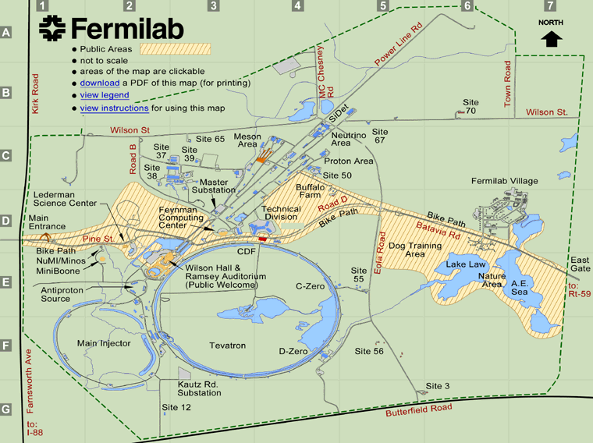

Slide 3
Particle Creation
Starting with hydrogen gas, scientists create proton beams
They strip off the electrons from H atoms
They divert a portion of the proton beams to create antiprotons
Once they have accumulated enough antiprotons, they load them into the Tevatron,

Slide 4
Particle Acceleration

Slide 5
Particle Acceleration

Slide 6
Particle Acceleration
http://www.youtube.com/watch?v=EKxzXAQJvB8
http://www.youtube.com/watch?v=robqSVeo5j0&feature=PlayList&p=792A1D3C49340E14&playnext_from=PL&playnext=1&index=66

Slide 7
Particle Detection
The purpose of particle detectors is to fully reconstruct a recorded eventIdentify the particles from the interactionElectron, muon, quark, neutrino, pion, …
Measure as many (all) properties of the particles as possibleMass, charge, momentum, spin, energy, lifetime, …
Reconstruct fundamental reaction mechanism Weak decay, strong interaction, …
Often, we can only ‘see’ the end products of the reaction, but not the reaction itself, for example, when particles decay rapidly
􀂄End result is the validation or falsification of a theory
􀂄Purpose is to measure as many properties of all particles as possible
Particles are detected through their interaction with matter Many different physical processes involved mainly of electromagnetic nature
Ultimately, we will always observe ionization and excitation of matter

Slide 8
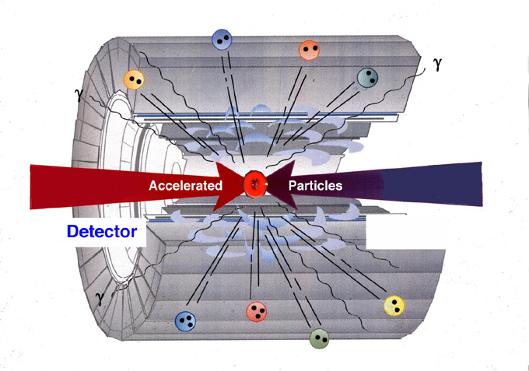
Particle Detection
1) Concentrate energy on particles (accelerator)
2) Collideparticles (recreate conditions after Big Bang)
•Collide two particlebeamshead on
•Collideparticle beam withstationary target
3) Identify created particles in
Detector(search for new clues)
Generally two types of detectors:
Collider detectors for colliding beam experiments
Fixed target experiments for Particle beams from accelerator on stationary target
Natural sources of particles: cosmic rays, neutrinos from the sun, …

Slide 9
Fermilab Detectors
Fermilab has two detectors
CDF
DØ

Slide 10
(CDF)

Slide 11
DØ detector

Slide 12
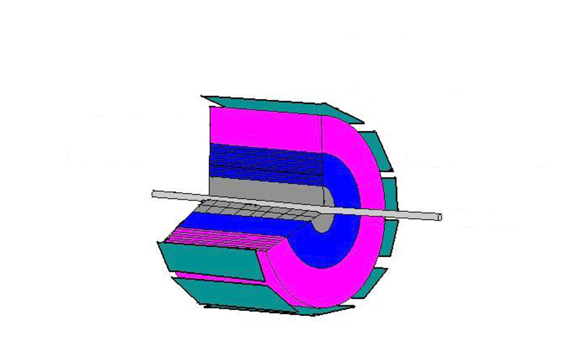
Simulated Detector for project
Introduction to the SRCH Detector
subsystems, their functions and performance

Slide 13
The accelerator provides a symmetric electron-positron beam.
Collisions will occasionally yield new particles.
Beam
Pipe
We hope to observe the decay of these new particles.

Slide 14
Detection begins in the silicon tracker.
A magnetic field will bend charged particles.
Silicon
Tracker
We measure the trajectory of charged particles.

Slide 15
Particles that interact electromagnetically will deposit energy here.
The calorimeter contains 20 layers of active material separated by lead sheets.
Electromagnetic
Calorimeter
This is a sampling detector.

Slide 16
Particles that interact strongly will deposit energy here.
The calorimeter contains 20 layers of active material separated by lead sheets.
Hadronic
Calorimeter
This is a sampling detector.

Slide 17
Muons interact very weakly.
We need a system that detects muons from any decays.
Muon
Catcher
This is a scintillating detector.

Slide 18
SRCH provides measurements of
momentum and energy of all charged decay products.

Slide 19
Fermilab Rap
http://www.youtube.com/watch?v=oaG6umMkbxg

